Slide 1

CSE- 321
Software Engineering
Lecture: 11 System modeling and UML
Fahad Ahmed
Lecturer, Dept. of CSE
E-mail: fahadahmed@uap-bd.edu

Slide 2
Lecture Outlines
Model
System Modeling
UML-Building Blocks
UML : Diagrams
Class Diagram
Object Diagram
Use case Diagram
UML Tools

Slide 3
Unified Modeling Language (UML)
The UML stands for Unified modeling language.
The UML is a language for
Visualizing
Specifying
Constructing
Documenting
the artifacts of a software-intensive system.
The Unified Modelling Language (UML) is an industry standard for object oriented design notation.
The Unified Modeling Language User Guide SECOND (2.0) EDITION
http://umlguide2.uw.hu/index.html

Slide 4
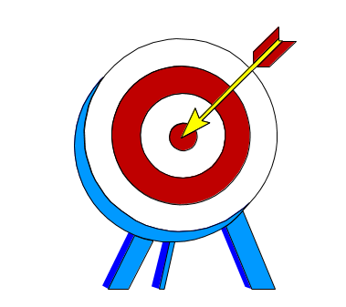
Unified Modeling Language (UML)
UML is not a programming language, it is rather a visual language.
We use UML diagrams to portray the behavior and structure of a system.
The UML builds models that are precise, unambiguous, and complete.
UML helps software engineers, businessmen and system architects with modelling, design and analysis.

Slide 5
Unified Modeling Language (UML)
The UML was developed in 1994-95 by Grady Booch, Ivar Jacobson, and James Rumbaugh at the Rational Software.
In 1997, it got adopted as a standard by the Object Management Group (OMG). This was the first version (V1.1) of UML. The OMG is best recognized for the Common Object Request Broker Architecture (CORBA) standards.
International Organization for Standardization (ISO) published UML as an approved standard in 2005.

Slide 6
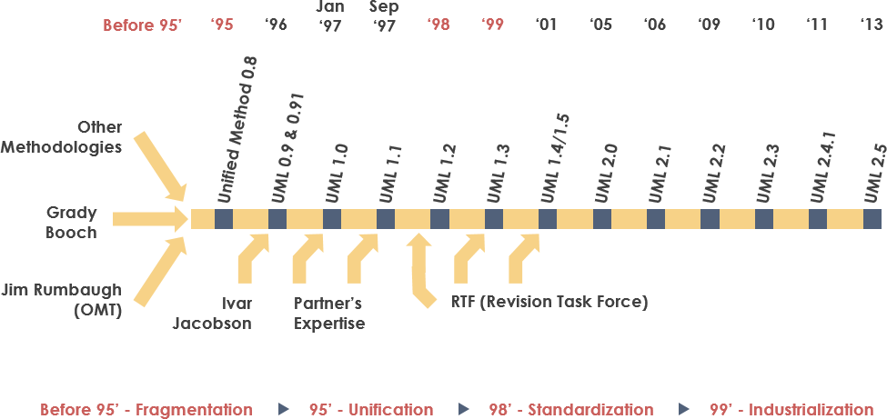
Unified Modeling Language (UML)

Slide 7
Characteristics of UML
The UML has the following features:
It is a generalized modeling language.
It is distinct from other programming languages like C++, Python, etc.
It is interrelated to object-oriented analysis and design.
It is used to visualize the workflow of the system.
It is a pictorial language, used to generate powerful modeling artifacts.

Slide 8
Where Can the UML Be Used?
The UML is intended primarily for software-intensive systems. It has been used effectively for such domains as
Enterprise information systems
Banking and financial services
Telecommunications
Transportation
Defence/aerospace
Retail
Medical electronics
Scientific
Distributed Web-based services
The UML is not limited to modeling software. In fact, it is expressive enough to model non-software systems, such as workflow in the legal system, the structure and behavior of a patient healthcare system, software engineering in aircraft combat systems, and the design of hardware.

Slide 9
Basics of the conceptual model
Some object-oriented concepts that are needed to begin with UML:
Object: An object is a real world entity. There are many objects present within a single system. It is a fundamental building block of UML.
Class: A class is a software blueprint for objects, which means that it defines the variables and methods common to all the objects of a particular type.
Abstraction: Abstraction is the process of portraying the essential characteristics of an object to the users while hiding the irrelevant information. Basically, it is used to envision the functioning of an object.

Slide 10
Basics of the conceptual model
Inheritance: Inheritance is the process of deriving a new class from the existing ones.
Polymorphism: It is a mechanism of representing objects having multiple forms used for different purposes.
Encapsulation: It binds the data and the object together as a single unit, enabling tight coupling between them.

Slide 11
UML-Building Blocks
Building Blocks of UML
Things
Relationships
Diagrams
Class, Interface,
Active class, Use case,
Component,
Collaboration, Node
Structural
Dependency,
Generalization,
Associations,
Realization
Use case,
Class,
Object,
Sequence,
Collaboration,
State chart,
Activity,
Component,
Deployment.
Behavioral
Interaction,
State Machine
Grouping
Package
Annotational
Note

Slide 12
UML-Building Blocks: Structural Things
There are 4 kinds of things in the UML
Structural Things
Behavioral Things
Grouping Things
Annotational Things
Structural Things
Structural things are the nouns of UML models. These are mostly static parts of a model, representing elements that are either conceptual or physical.
There are 7 kinds of Structural things:
Class
Interface
Collaboration
Use case
Actor
Component
Node

Slide 13
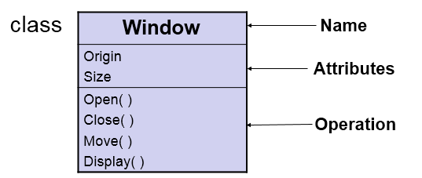
UML-Building Blocks: Structural Things
Class:-
A class is a description of a set of objects that share the same attributes, operations, relationships and semantics.
A class implements one or more interfaces.

Slide 14
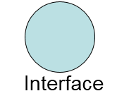
UML-Building Blocks: Structural Things
(2) Interface:-
Interface is a collection of operations that specify a service of a class or component.
An interface describes the externally visible behavior of that element.
An interface defines a set of operation specifications but never a set of operation implementations.
Graphically, an interface is represented as a circle with its name.

Slide 15
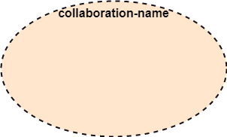
UML-Building Blocks: Structural Things
(3) Collaboration:-
A collaboration defines an interaction and is a society of roles and other elements that work together to provide some cooperative behavior.
Therefore, collaboration have structural as well as behavioral dimensions.
Graphically a collaboration is represented as an ellipse with dashed lines, usually including only its name.

Slide 16
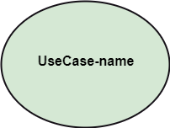
UML-Building Blocks: Structural Things
(4) Use case:-
A Use case is a description of set of sequence of actions that a system performs, which results a value to a particular actor.
A use case is used to structure the behavioral things in a model.
A use case is realized by a collaboration.

Slide 17
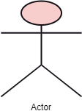
UML-Building Blocks: Structural Things
(5) Actor:-
Actor: It comes under the use case diagrams. It is an object that interacts with the system, for example, a user.

Slide 18
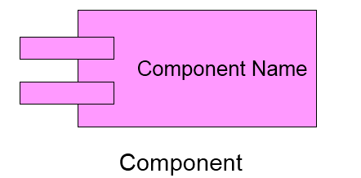
UML-Building Blocks: Structural Things
(6) Component:-
A component is a physical and replaceable part of a system that conforms to and provides the realization of a set of interfaces.
A component represents the physical packaging of logical elements such as classes, interfaces and collaborations.

Slide 19
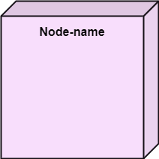
UML-Building Blocks: Structural Things
(7) Node:-
A node is physical element that exists at run-time and represents a computational resource, generally having some memory and processing capability.
A set of components may reside on a node and may also migrate from node to node.

Slide 20
UML: Behavioral Things
These are the dynamic parts of UML models.
These are the verbs of a model representing the behavior over time and space.
There are two types of behavioral things
1. Interaction
2. State machine.

Slide 21

UML: Behavioral Things
Interaction:-
An Interaction is a behavior that comprises a set of messages exchanged among a set of objects within a particular context to perform a specific purpose.
An interaction involves a number of other elements, including messages, action sequences and links. (connection between objects.)

Slide 22
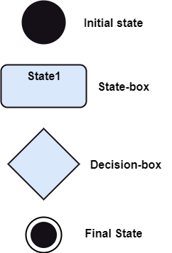
UML: Behavioral Things
(2) State machine:-
A State machine is a behavior that specifies the sequences of states an object or an interaction goes through during its lifetime in response to events, together with its responses to those events.
A State machine involves a number of other elements, including states, transitions( the flow from state to state), events (things that trigger a transition), and activities ( the response to a transition).

Slide 23
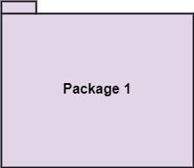
UML: Grouping Things
Grouping things are the organizational parts of UML models.
In all, there is one primary kind of grouping thing, namely, Package.
Package:-
A Package is a general-purpose mechanism for organizing elements into groups.
Structural things, behavioral things and even other grouping things that may be placed in a package.
Unlike component (which exist at run time), package is purely conceptual (meaning that it exist only at development time).

Slide 24
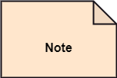
UML: Annotational Things
Annotational Things are the explanatory parts of the UML models.
These are the comments you may apply to describe, illuminate and remark about any element in a model.
There is one primary kind of Annotational thing, called a Note.
Note:- A Note is simply a symbol for representing constraints and comments attached to an element or a collection of elements.
A note is rendered as a rectangle with a
dog-eared corner.

Slide 25
Relationships in the UML
There are four kinds of relationships in the UML.
1. Dependency
2. Association
3. Generalization
4. Realization
These relationships are the basic relational building blocks of the UML. These are used to write well-formed models.

Slide 26
Relationships in the UML
DEPENDENCY:-
A Dependency is a semantic relationship between two things in which a change to one thing( the independent thing) may affect the semantics of the other thing (the dependent thing).
ASSOCIATION:-
A set of links that associates the entities to the UML model. It tells how many elements are actually taking part in forming that relationship.
It is denoted by a dotted line with arrowheads on both sides to describe the relationship with the element on both sides.

Slide 27

Relationships in the UML
GENERALIZATION:-
A generalization is a specialization/generalization relationship in which objects of the specialized elements (the child) are substitutable for objects of the generalized elements (the parent).
In this way, the child shares the structure and the behavior of the parent.
Represented as a solid line with a hollow arrow head pointing to the parent.

Slide 28

Relationships in the UML
REALIZATION:-
A realization is a semantic relationship between classifiers, wherein one classifier specifies a contract that another classifier guarantees to carryout.
We will encounter realization relationships in two places: between interfaces and classes or components that realize them, and between use cases and the collaborations that realize them.

Slide 29
UML : Diagrams
A diagram is the graphically presentation of a set of elements, most often represented as a connected graph of vertices (things) and arcs (relationships).
Diagrams visualize a system from different perspectives, so a diagram is a projection into system.
UML is linked with object oriented design and analysis.
Diagrams in UML can be broadly classified as:
Structural Diagrams
Behavior Diagrams

Slide 30
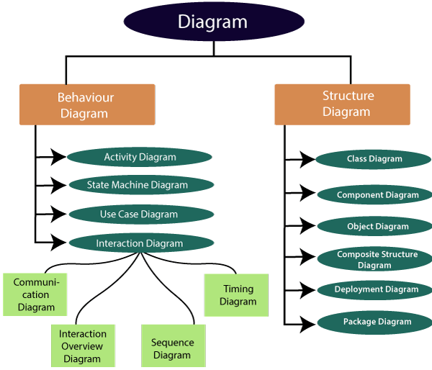
UML : Diagrams

Slide 31
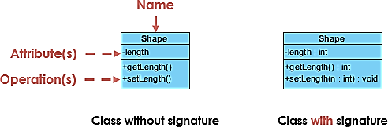
UML : Class Diagram
UML Class Diagram
The class diagram depicts a static view of an application. It represents the types of objects residing in the system and the relationships between them.
Purpose of Class Diagrams
It analyses and designs a static view of an application.
It describes the major responsibilities of a system.
It is a base for component and deployment diagrams.
It incorporates forward and reverse engineering.
Vital components of a Class Diagram
Upper Section
Middle Section
Lower Section

Slide 32
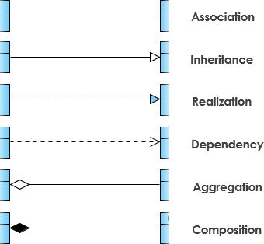
UML : Class Diagram
Relationships
https://creately.com/blog/diagrams/class-diagram-relationships/

Slide 33
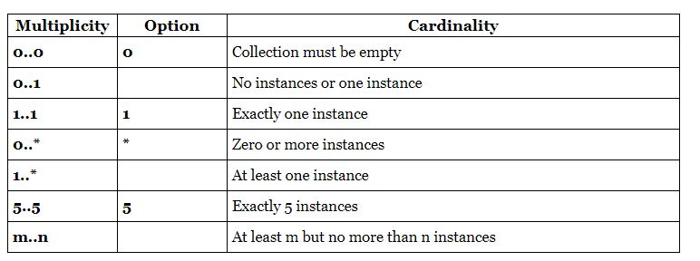
UML : Class Diagram
Cardinality
Cardinality is expressed in terms of:
one to one
one to many
many to many

Slide 34
UML : Class Diagram
How to draw a Class Diagram?
To describe a complete aspect of the system, it is suggested to give a meaningful name to the class diagram.
The objects and their relationships should be acknowledged in advance.
The attributes and methods (responsibilities) of each class must be known.
A minimum number of desired properties should be specified as more number of the unwanted property will lead to a complex diagram.
Notes can be used as and when required by the developer to describe the aspects of a diagram.
The diagrams should be redrawn and reworked as many times to make it correct before producing its final version.

Slide 35
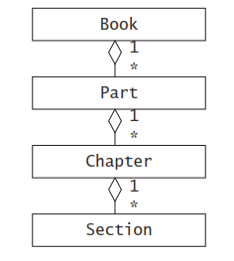
UML : Class Diagram
Draw a class diagram representing a book deﬁned by the following statement:
“A book is composed of a number of parts, which in turn are composed of a number of chapters. Chapters are composed of sections.”
Focus only on classes and relationships.
Classes are represented with rectangles.
The attribute and operations compartment can be omitted.
Aggregation relationships are represented with diamonds.
Class names start with a capital letter and are singular.

Slide 36
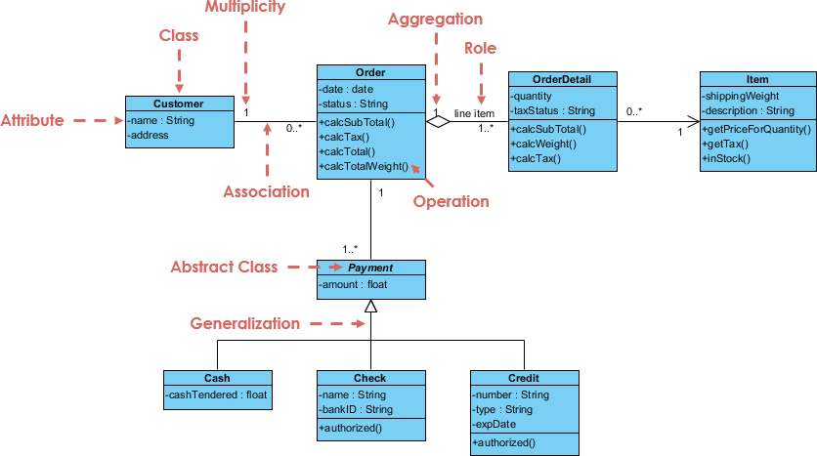
UML : Class Diagram
Class Diagram Example: Order System
https://www.uml-diagrams.org/class-diagrams-examples.html

Slide 37

Thanks to All

